Slide 1
Living Obituary
Johnny
A gathering

Slide 2
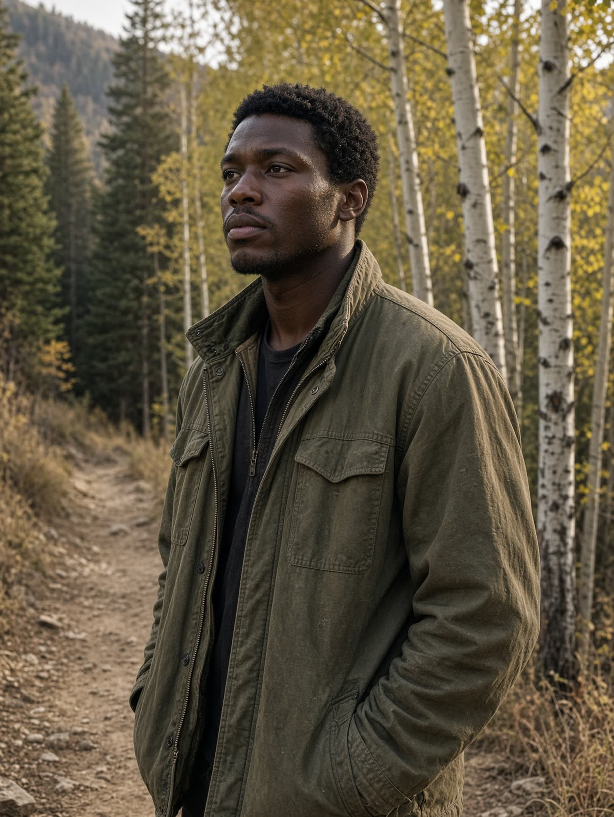
Late light on the trail. Ordinary Tuesday. Luis is just out of frame arguing about the map.

Slide 3
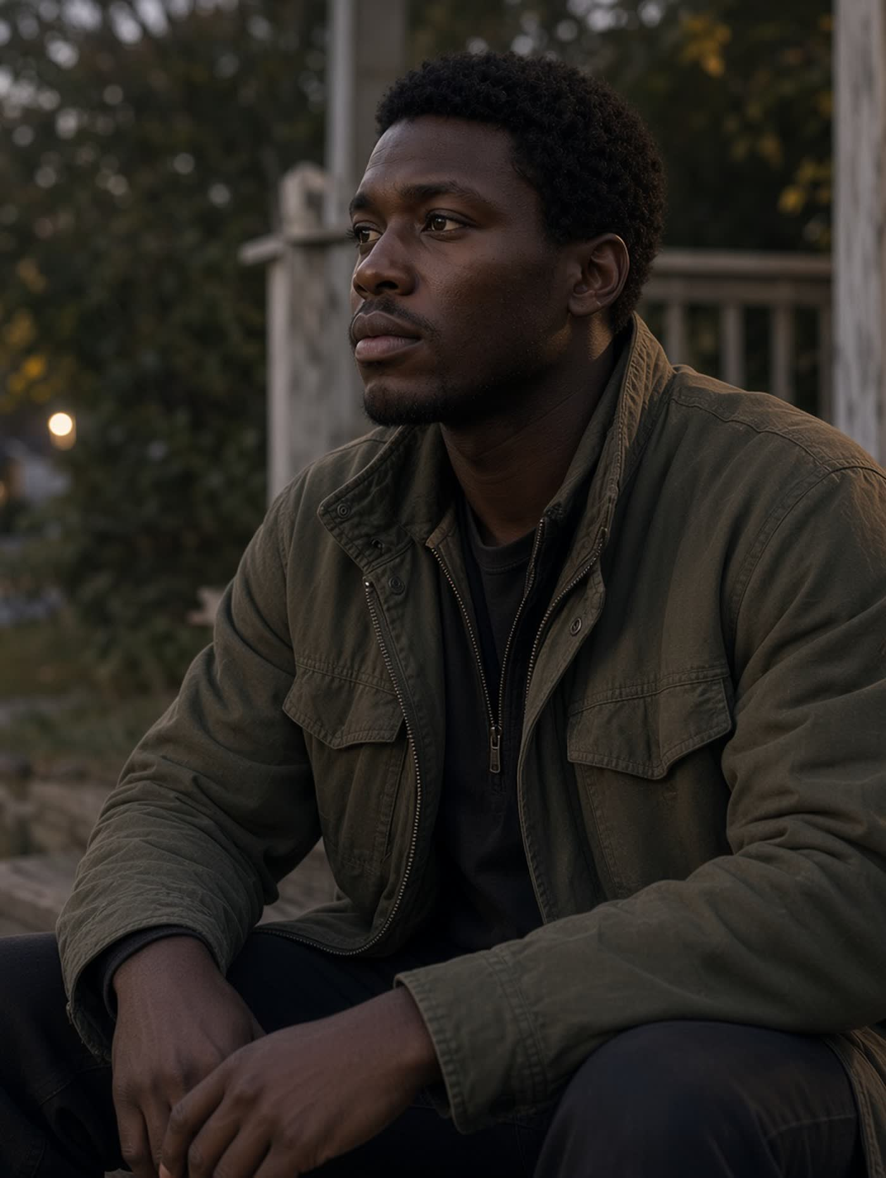
Mom on the porch. We did not talk about the diagnosis the whole time.

Slide 4
The portrait. Window light. This is the one they can use.

Slide 5
Johnny
Living Obituary

