Slide 1
Living Obituary
Betty Sue
A memorial gathering
A song to play from a phone: Precious Lord

Slide 2
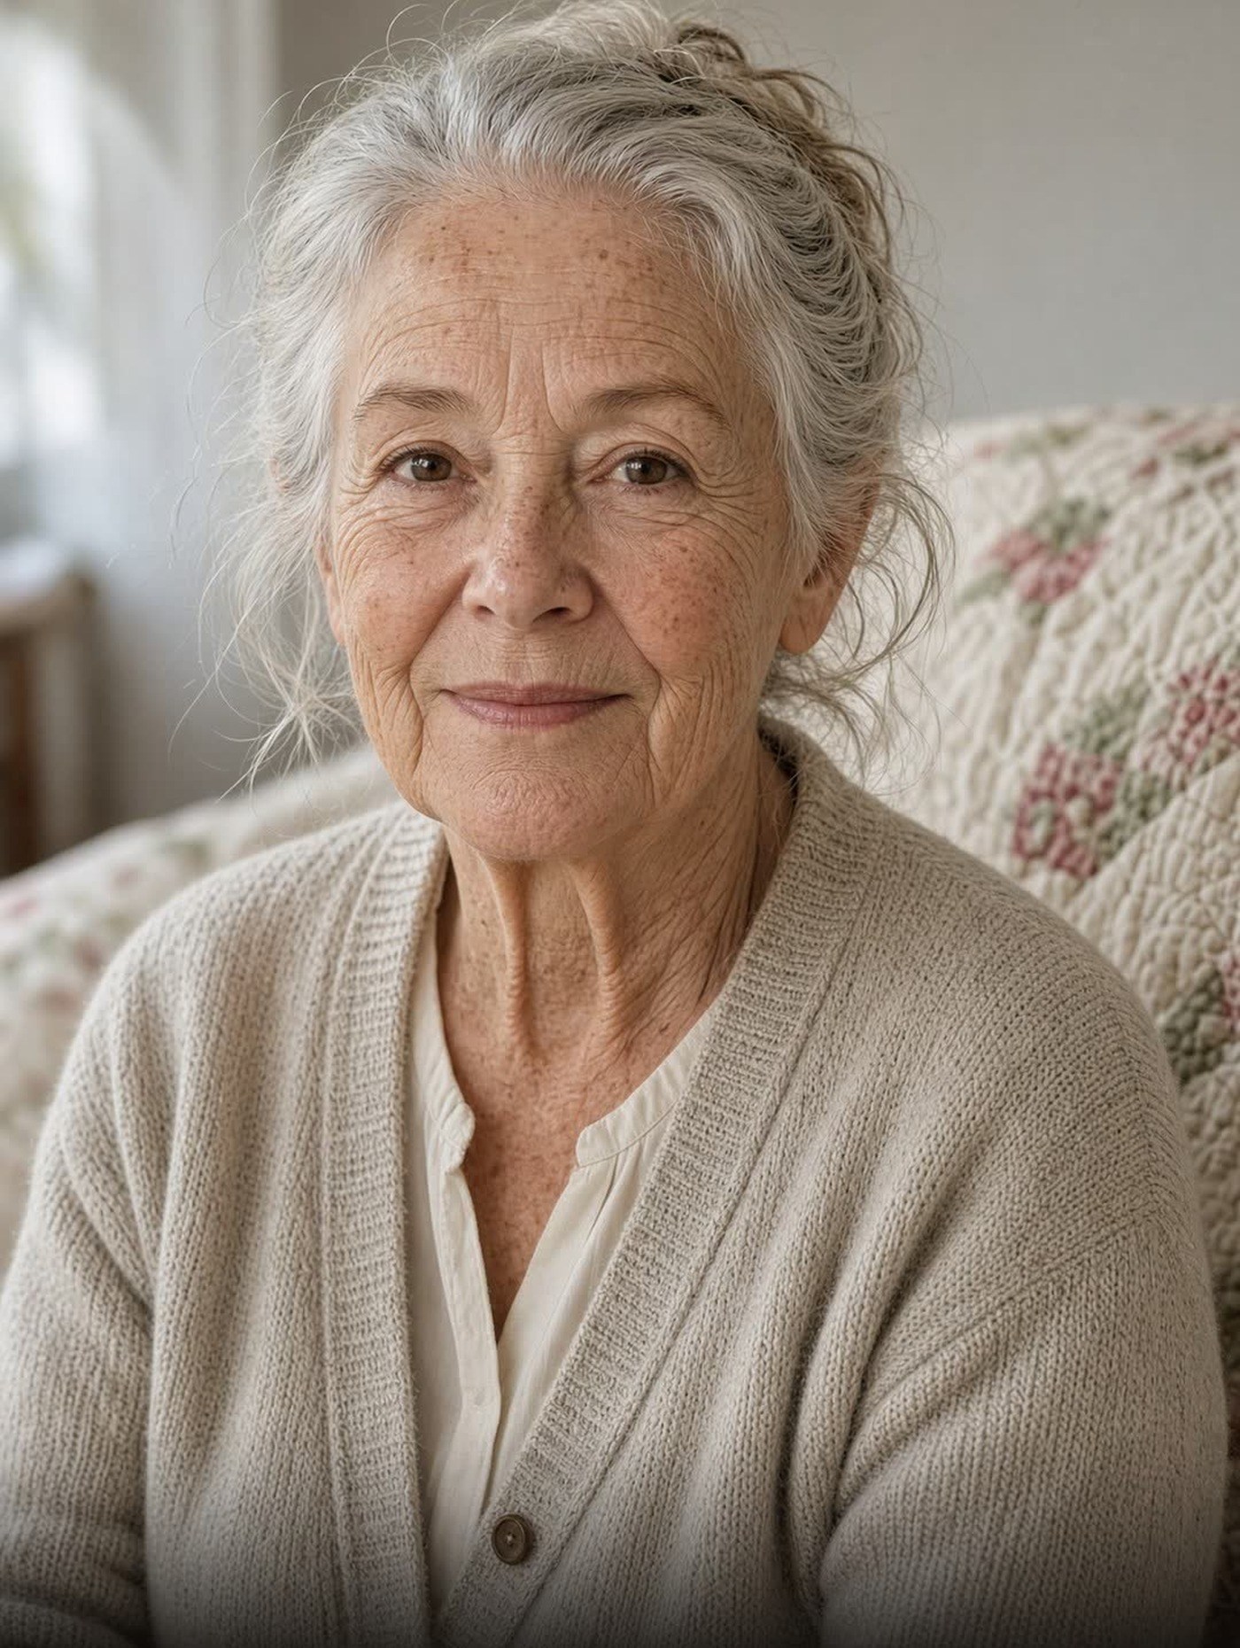
The photograph she chose for the first frame.

Slide 3
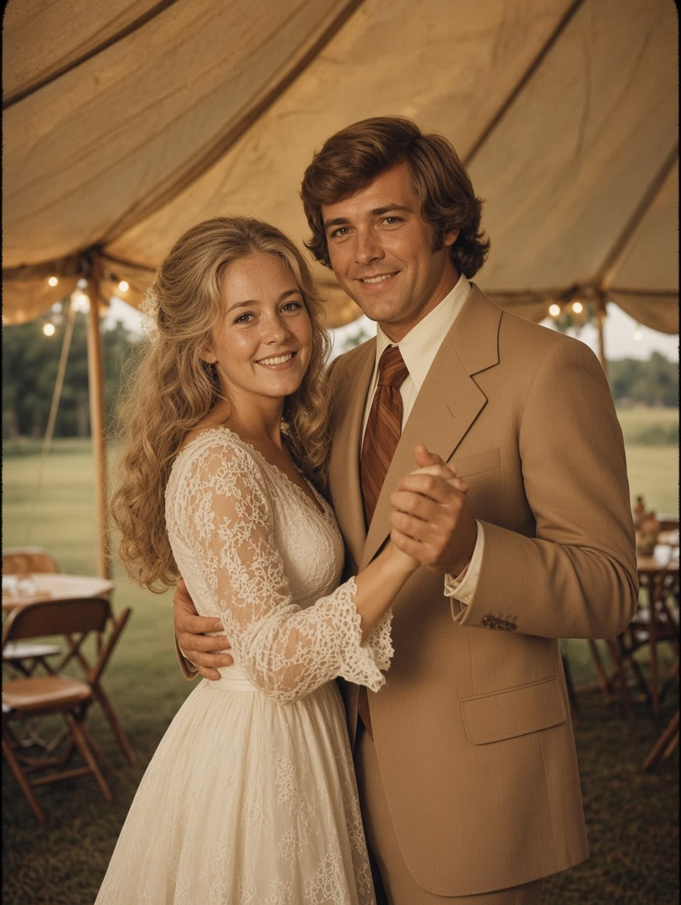
Reception, 1971. Robert could not dance. He danced anyway.

Slide 4
Betty Sue
Living Obituary

